Slide 1
Do You Feel What I Hear? Enabling Autonomous IoT Device Pairing using Different Sensor Types
2018 IEEE Symposium on Security and Privacy (SP)
Jun Han, Albert Jin Chung, Manal Kumar Sinha, Madhumitha Harishankar, Shijia Pan, Hae Young Noh, Pei Zhang, and Patrick Tague
Carnegie Mellon University

Slide 2
Abstract
Context-based pairing solutions increase the usability of IoT device pairing by eliminating any human involvement in the pairing process.
by utilizing on-board sensors (with same sensing modalities) to capture a common physical context .
The Problem of common physical context is that it is impractical in a smart home scenario.
This paper propose a new context-based pairing mechanism, Perceptio’s pairing protocol which uses time as the common factor across differing sensor types.
Notes:
Context-based pairing solutions代表：利用前後相同的資訊來做到pairing。
在Pairing process中，Context-based pairing可以消除人為介入，使得增加IoT device pairing的可用性。
Context-based pairing怎麼做？
利用有在運作的sensors with same sensing modality找出common physical context。 e.g.周遭的聲音都用麥克風收
common physical context的問題：在智慧家庭中很難實踐，因為all devices不會去share common physical context。 e.g. motion detector有紅外線sensor，但Echo只有麥克風。
這篇論文提供Perceptio(new context-based pairing mechanism)，利用time來當作不同sensor types的common factor，而不用再管event sensor data，以event timing找出event fingerprints，來比對不同種類的IoT device。

Slide 3
Abstract
: Perceptio
Perceptio’s pairing protocol is based on …
Devices co-located within a physically secure boundary is legitmate.
Distinguish between legitimate devices and attacker devices by imposing a threshold on fingerprint similarity.
Devices make use of the observed contextual information to provide entropy.
Perceptio is evaluated its effectiveness as an autonomous secure pairing solution.
Notes:
Perceptio
前提： 在physically secure boundary中的devices都可以co-located(share a location or facility with someone/something else.) e.g. physically secure boundary=single family house 所以，比起outside devices，可以觀察到同在physically secure boundary的events in common over time。
pairing protocol： 因為有observed contextual information，可以提供entropy。 因為在同個boundary，利用fingerprint similarity設threshold，就能夠分辨是否為legitimate devices。 e.g. 找出legitimate device有94.9%；找出表現很好的attacker有68.9%能區別。
Perceptio可以作為autonomous secure pairing solution

Slide 4
OUTLINE
Introduction
Background and Relevant related work
Models and Assumptions
Entropy extraction and Fingerprinting
Protocol Design
Implementation
Evaluation
Deployment considerations
Limitations
Conclusions

Slide 5
Introduction
: IoT devices
IoT devices
provide significant value to smart home operations
contain privacy-sensitive information
E.g. user activities within the home
[74] Xiao Wang and Patrick Tague. Non-invasive user tracking via passive sensing: Privacy risks of time-series occupancy measurement. In Proceedings of the 2014 Workshop on Artificial Intelligent and Security Workshop, AISec ’14, 2014.
[31] Jun Han, Albert Jin Chung, and Patrick Tague. Pitchin: Eavesdropping via intelligible speech reconstruction using non-acoustic sensor fusion. In 16th ACM/IEEE International Conference on Information Processing in Sensor Networks (IPSN), 2017.
Notes:
目的：為smart home operations提供價值
引來：privacy-sensitive info. e.g. user activities within the home [74] Xiao Wang and Patrick Tague. Non-invasive user tracking via passive sensing: Privacy risks of time-series occupancy measurement. In Proceedings of the 2014 Workshop on Artificial Intelligent and Security Workshop, AISec ’14, 2014.：大規模的sensing幫助了很多應用，卻將使用者的location traces 變成 room-level occupancy data。而且不像是explicit tracking(e.g. camera)，有time-series occupancy traces(就是aggregated environ. measurements, synthetic data)就像private-preserving。最後會提出採用隱私機制可以控制資訊被sensing system的流出。 [31] Jun Han, Albert Jin Chung, and Patrick Tague. Pitchin: Eavesdrop-ping via intelligible speech reconstruction using non-acoustic sensor fusion. In 16th ACM/IEEE International Conference on Information Processing in Sensor Networks (IPSN), 2017.：此篇提出a new side-channel attack，把此攻擊方法叫做PitchIn，也有提出實踐。攻擊者入侵了你原本不在意的non-acoustic sensors(e.g.geophones, accelerometers, and gyroscopes)，藉由重建可以被理解的聲音訊號來發動竊聽攻擊。 [33] Jun Han, Abhishek Jain, Mark Luk, and Adrian Perrig. Don’t sweat your privacy: Using humidity to detect human presence. In Proceedings of 5th International Workshop on Privacy in UbiComp (UbiPriv’07), September 2007：環境中很多測量濕度、溫度、光等的on-board sensor chip等看起來無害，但可以揭露人的隱私資訊，並調查有沒有任何方式可以防止隱私資訊的外洩。 [49,52]都在說smart grid(meter)會揭露你的家庭活動行為（用電啊、人口數等等）

Slide 6
Introduction
: IoT devices
[33] Jun Han, Abhishek Jain, Mark Luk, and Adrian Perrig. Don’t sweat your privacy: Using humidity to detect human presence. In Proceedings of 5th International Workshop on Privacy in UbiComp (UbiPriv’07), September 2007
[49,52] Smart grid, Smart meter
Securing the wireless communication among IoT devices is thus a critical capability for any home IoT deployment.
Securing pairing with existing devices is through cryptographic key establishment.
Against the attacks
MitM(man-in-the-middle)
Protocol manipulation attacks: Bluetooth, WiFi, Seeing is Believing, … etc. [43] A. Kumar, N. Saxena, G. Tsudik, and E. Uzun. A comparative study of secure device pairing methods. Pervasive and Mobile Computing, 5(6):734–749, 2009.
Notes:
所以重視=critical capabiilty：wireless communication security
How:
cryptographic key establishment:將存在的設備和新加入的設備做安全配對(pairing)。 無線裝置中間要建立安全的連線，要work together device的context，要先連線：完全無信任、無事先的context的狀態下，bootstrapping＝pairing。 在bootstrapping＝pairing這之前有沒有可能有資安的風險（老師想知道的）。
Against:
MitM(man-in-the-middle)
protocol manipulation attacks [38,29]Bluetooth [6]WiFi [48]Seeing is Believing [25]muatually [71]shake [43] A. Kumar, N. Saxena, G. Tsudik, and E. Uzun. A comparative study of secure device pairing methods. Pervasive and Mobile Computing, 5(6):734–749, 2009. ：就是上次學長報告的。
未曾連接過的設備，為了往後傳輸，在安全通道、使用者接受，做“配對”
同一個使用者，有兩個裝置要配對的使用情境。
很多配對方法，但實用性！？對使用者友善？
整合當時的方法，放在同一個裝置上，測試、實驗。
注意實用＆安全性
Usability:friendly, convenient, useful
Security:user inconvenient

Slide 7
Introduction
: IoT devices
_{reference}
[74] Xiao Wang and Patrick Tague. Non-invasive user tracking via passive sensing: Privacy risks of time-series occupancy measurement. In Proceedings of the 2014 Workshop on Artificial Intelligent and Security Workshop, AISec ’14, 2014.
Massive sensing cause location traces of users to room-level occupancy data rather than explicit tracking.
The time-series occupancy traces is like private-preserving data from aggregated environment measurements and synthetic data.
This paper propose a private mechanism to control the leak of information from sensing system.
Notes:
[74] 大規模的sensing幫助了很多應用，卻將使用者的location traces 變成 room-level occupancy data。而且不像是explicit tracking(e.g. camera)，有time-series occupancy traces(就是aggregated environ. measurements, synthetic data)就像private-preserving。最後會提出採用隱私機制可以控制資訊被sensing system的流出。

Slide 8
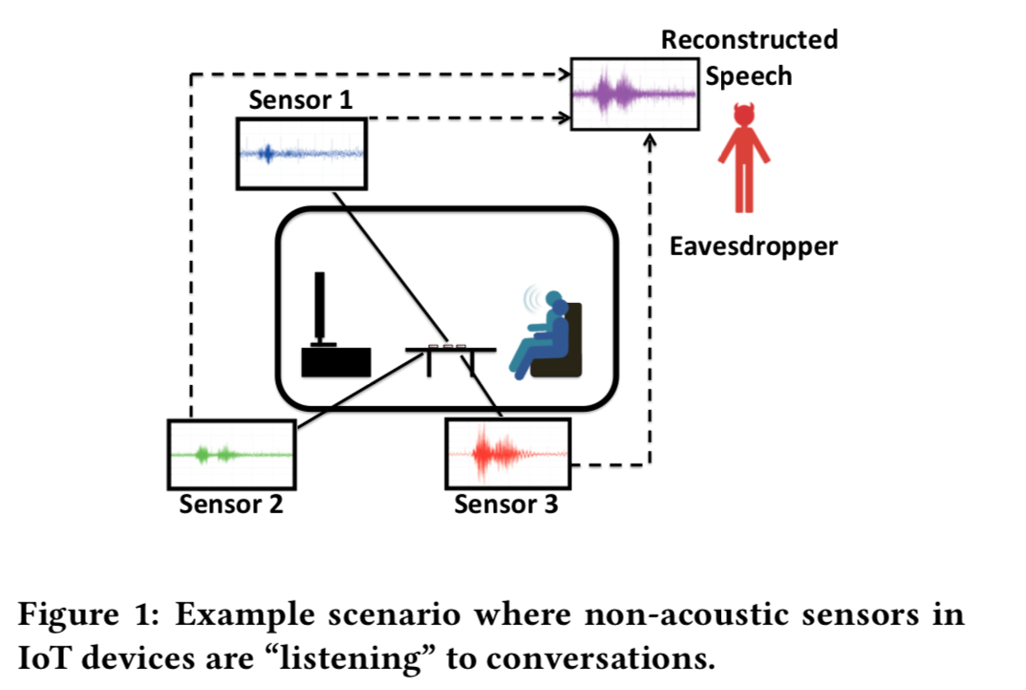
Introduction
: IoT devices
_{reference}
[31] Jun Han, Albert Jin Chung, and Patrick Tague. Pitchin: Eavesdropping via intelligible speech reconstruction using non-acoustic sensor fusion. In 16th ACM/IEEE International Conference on Information Processing in Sensor Networks (IPSN), 2017.
This paper propose and implement a new side-channel attack called PitchIn.
Attacker invades the device with non-acoustic sensors that you didn’t notice before and reconstruct the signals to understanding speech.
Notes:
[31].：此篇提出a new side-channel attack，把此攻擊方法叫做PitchIn，也有提出實踐。攻擊者入侵了你原本不在意的non-acoustic sensors(e.g.geophones, accelerometers, and gyroscopes)，藉由重建可以被理解的聲音訊號來發動竊聽攻擊。

Slide 9
Introduction
: IoT devices
_{reference}
[33] un Han, Abhishek Jain, Mark Luk, and Adrian Perrig. Don’t sweat your privacy: Using humidity to detect human presence. In Proceedings of 5th International Workshop on Privacy in UbiComp (UbiPriv’07), September 2007
There are multiple on-board sensor chips of measuring humidity, temperature, and light in the environment. They might possible to leak the private information even looking like harmless.
Notes:
[33] ：環境中很多測量濕度、溫度、光等的on-board sensor chip等看起來無害，但可以揭露人的隱私資訊，並調查有沒有任何方式可以防止隱私資訊的外洩。

Slide 10
Introduction
: IoT devices
_{reference}
[45] P. McDaniel and S. McLaughlin. Security and privacy challenges in the smart grid. IEEE Security Privacy, 2009.
[52] Andrés Molina-Markham, Prashant Shenoy, Kevin Fu, Emmanuel Cecchet, and David Irwin. Private memoirs of a smart meter. In Proceedings of the 2Nd ACM Workshop on Embedded Sensing Systems for Energy-Efficiency in Building, BuildSys ’10, 2010.
Both of them is about the smart grid(meter) will reveal your behavior and activities within home. E.g. Power consumption, Population
Notes:
[49,52]都在說smart grid(meter)會揭露你的家庭活動行為（用電啊、人口數等等）

Slide 11
Introduction
: Protections
Human-in-the-loop solution
However, it is not feasible for many IoT systems for two reasons: 1. IoT devices increase from around ten to several hundred within the next decade. 2. Most emerging IoT devices do not have a user interface . In the past, the solutios are - pre-loaded keys - user interfaces - dedicated pairing hardware E.g. NFC
However, such approaches would overburden manufacturers.
Context-based pairing solution Reduce human involvement and use the emergence of context-based pairing to achieve secure pairing process.
Notes:
human-in-the-loop solutions:需要人介入protocol e.g. 打密碼
問題：Not feasible
IoT devices會越來越多(10 to 100) in next decade，對人是負擔
大多IoT devices沒有user interface，所以很難直接輸入密碼和管理。
通常被解決的方式：
pre-loaded keys
user interfaces
dedicated pairing hardware e.g. NFC
解決後帶來的問題：
製造商的負擔
IoT發展變慢
解決：減少人的介入。
減少人的介入。用emergence of context-based pairing來做到secure pairing process。

Slide 12
Introduction
: Protections
_{Context-based pairing solution}
Principle : co-present devices will observe the similar events.
Solution : on-board sensors to extract entropy from the surrounding environment.
The sensor measurements translated to randomness, forming the basis of a symmetric key agreement protocol.
The unpredictability of the activities in the environment provides the entropy source.
Approach: usable and secure IoT device pairing 1. Find a common, properly calibrated sensing capability across all devices. E.g., a microphone or light sensor on each device
Notes:
減少人的介入。用emergence of context-based pairing來做到secure pairing process。
Principle：co-present devices會觀察到相似的events
作法：根據on-board sensors去從周遭環境中萃取出entropy。
common sensor測量方法轉變成common隨機性，作為symmetric key agreement protocol的基礎。
環境中的活動不可預測性(unpredictability)，提供了entropy source和減少人為參與。
步驟：
對usable和secure的IoT device pairing： 依據across all devies的common, properly calibrated sensing capability. e.g.麥克風或是light sensor
現實問題：因為smart home的diversity of hardware capability，所以要考慮device heterogeneity來做到usable pairing protocol。
啟發：因為現在IoT有小數量(often only one)的sensor來optimize cost, power consumption, and form factor。
挑戰：
heterogeneous device landscape= different sensing modality sensor measurements不同，所以不能直接比較
different chipsets or calibration methods same type用不同方式測量event。
解決：heterogeneous sensor-based pairing protocols 找一個適合且固定的屬性(property)，可以被不同configuration的device測量。

Slide 13
Introduction
: Protections
_{Context-based pairing solution}
_{Approach}
2. Because of the diversity of hardware capability in smart home, the device heterogeneity should be considered. (For usable)不同的sensing Challenges:
- Heterogeneous device landscape, that is, different sensing modality, cannot compare directly. - Even sensors of the same type may measure an event in a different way because of different chipsets or calibration methods.
3. Emerging IoT products that often have only one embedded sensors to optimize cost, power consumption, and form factor. 4. Rely on a suitable invariant property measured by devices with a wide variety of configurations.
Notes:
步驟：
對usable和secure的IoT device pairing： 依據across all devies的common, properly calibrated sensing capability. e.g.麥克風或是light sensor
現實問題：因為smart home的diversity of hardware capability，所以要考慮device heterogeneity來做到usable pairing protocol。
啟發：因為現在IoT有小數量(often only one)的sensor來optimize cost, power consumption, and form factor。
挑戰：
heterogeneous device landscape= different sensing modality sensor measurements不同，所以不能直接比較
different chipsets or calibration methods same type用不同方式測量event。
解決：heterogeneous sensor-based pairing protocols 找一個適合且固定的屬性(property)，可以被不同configuration的device測量。

Slide 14




Introduction
: Protections
_{Context-based pairing solution}
_{Approach}
Goal : find a good property
It is part of sensory data observed from different IoT devices
It contains contextual content
It must be stronger understanding
analogous human behavior through the following scenario.
怎麼證明知道的是同一件事情
in the IoT device regime
Heterogeneous devices (desperate sensing)
Timing information as an invariant property
“numerically different yet contextually similar”
event
Notes:
找到好的property的過程： ，就像是從一個場景中找到人們相似的行為。 ➡ in the IoT device regime
要從不同IoT devices上可以被觀察到的sensory data
包含contextual content
必須stronger understanding
假設房間裡有兩個人，一個聽力受損、一個視覺受損。當門將門關起來，兩個人必須在同時間觀察event，（所以他們就要用不同的senses，用看的、用聽的），因為時間的關係，兩個人可以分享他們觀察到的並確定他們觀察(witness)到的是同一個事件。
類似的事情就像是我們常常用很多感官觀察一件事，像是雨下下來，你可以聽、感覺、看到水滴。
➡ in the IoT device regime
在heterogeneous devices（desperate sensing)中
leverage timing infö. as an invariant property： “numerically different yet contextually similar”

Slide 15
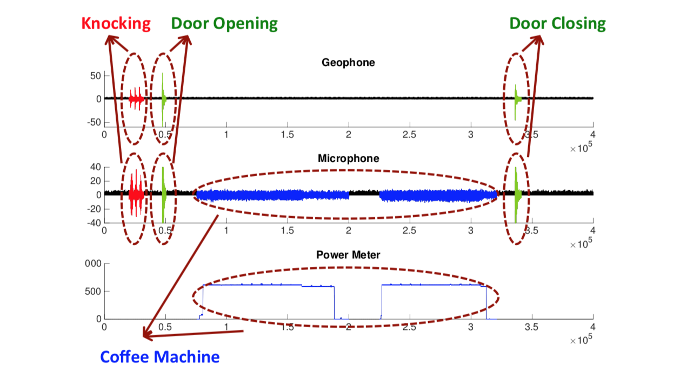
Introduction
: Protections
_{Context-based pairing solution}
Bob
Dan
Coffee machine
Notes:
在喝完咖啡後，Dan回房間並關上門。
➡ Bob: geophone地震波檢測器
➡ Dan: microphone
➡ coffee machine: power meter功率計
下圖表示corresponding sensor readings
事情發生經過

Slide 16
Introduction
: Protections
_{Context-based pairing solution}
Sensing devices can detect relevant events, group them by event type (e.g., using unsupervised clustering)把時間區隔當成指紋
Time interval between subsequent occurrence of each event type
Map the time interval measurements to a collection of fingerprints.
Fingerprints can then be incorporated into a verification algorithm to prove co-presence
Then fingerprints contribute to the generation of a shared symmetric key.
Notes:
在一個更普遍的情景中，sensing devices可以偵測相關的事件，並（e.g.透過unsupervised clustering)把他們group by event type。
怎麼去group?
每個event type之間的time interval map to fingerprints collections.
Fingerprints放進verification algo 以證明共同存在(co-presence)及產生共享的symmetric key：每個device有sensing capabilities，可以合作(incorporated)different fingerprints去驗證(是否group)。

Slide 17
Introduction
: Protections
_{Context-based pairing solution}
Not using signals? Too many descriptive signals to use fingerprint verification.
Using inter-event timing? Might remove some useful signal content, this comes in trade for support of many critical aspects of practical fingerprint verification.
A high degree of tolerance, including…
Different hardware or sensor calibration methods
Signal attenuation due to variations proximity between sensors and events
measurements from different sensor types
Notes:
討論：
為什麼不記錄每個signals？ 雖然我們使用inter-event timing(time interval)（後面讀過來補充：跟下一個same type的event之間的time）消除了一些有用的信號內容，但這是為了支持實際fingerprint verification的許多關鍵方面，這時候就不太可能使用更多描述型(descriptive)的訊號。例如numerical signals
最重要的事，消除numerical訊號features帶來更高的包容度(high degree of tolerance)，包容了：
不同的hardware/sensor矯正的methods
sensors和events因為接近的變動性(variations in proximity)導致的訊號衰減(attenuation)
來自不同sensor types的測量方法
還有，devices部會需要為了測量時間去辨別事件本身，但可以簡單地用非監督式學習把事件分群，等等會討論到。

Slide 18
Introduction
: Protections
_{Context-based pairing solution}
IoT devices deployed in a common environment are intended to collaborate as part of the same smart home system.
An implicit human-driven intent as long as they can determine that they are deployed in the same place.
Context of single-family home brings…
physical sensing barrier for observing different activities.
typical physical security that reduces to verifying co-presence.
Notes:
這邊在假設（已知insight)一個情況
在相同環境(same smart home system)中，IoT devices會傾向和其他合作。
討論:
確定他們在相同環境： 就像implicit human-driven intent的方式幫助配對。
context of single-family home：
physical sensing barrier 包含房子裡面的東西和結構，在sensor(e.g. vibration, sound, light, electrical load)觀察到很多不同種活動時會有障礙
typical physical security
context可以帶來: the secure pairing problem reduces to verifying co-presence within the home.(讓安全pairing的問題變成是驗證家中device的co-presence)
此篇驗證device co-presence的方法
利用了以下事實：
部署在屋子內同房間的設備，隨著時間觀察到大多相同的事件
房子外的設備觀察到不同/明顯衰減(attenuated)的事件

Slide 19
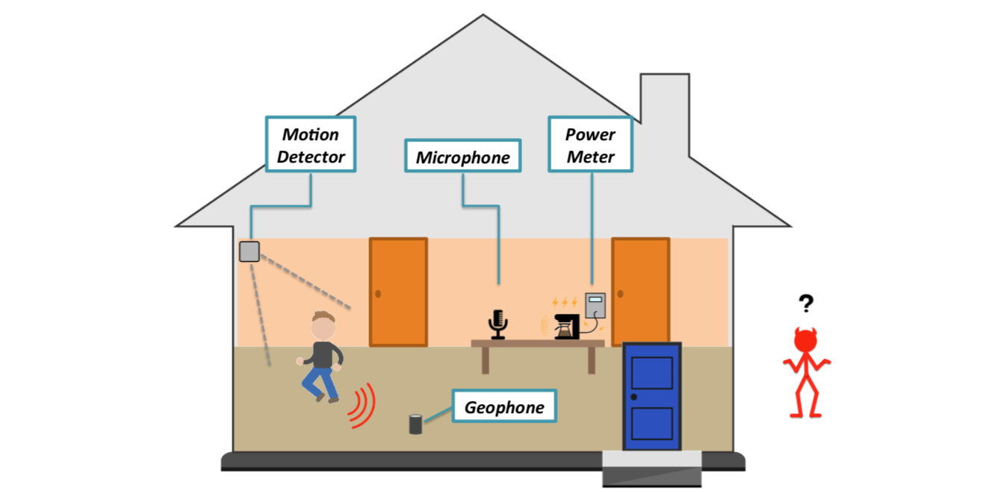
Introduction
: Protections
_{Context-based pairing solution}
Autonomous verifying that devices are co-presence
Random events offer necessary entropy from user activities
Verification is based on sensory perception
Perceptio – autonomous device pairing technique.
Notes:
狀況： 由user活動產生的Random events(e.g. walking, making coffee)提供必須的entropy來實現co-presence verification。
由上述可知，方法是在環境中，基於對事件的sensory perception
這方法叫做：Perceptio 可以裝置自動化匹配(autonomous device pairing)
從圖來看high-level ideas of Perceptio，
，屋內的devices觀察到的physical events，無法被外界的攻擊者清楚地觀察。

Slide 20
Introduction
: Protections
_{Context-based pairing solution}
_{Perceptio}
Advantages:
IoT devices are able to effectively fingerprint their surroundings
Without human involvement
Achieve MAX usability
An outside attacker can neither accurately observe nor predict events at the temporal granularity required for verification.
Perceptio has Key Strengthening Process
Key Strengthening Process
Is like multi-round security protocol 隨著時間增加會使key強度變強
builds confidence in co-presence verification over time.
Initial shared key → augments the key with subsequent fingerprint information → desired strength
Notes:
由此可知，Perceptio
優點：
讓IoT devices可以有效的fingerprint出周遭
不需要人為介入
達到最大的可用性(usability)
使用fingerprints來：
symmetric key establishment
外界的攻擊者無法清楚的觀察、預測events的時間間隔(temporal granularity)。
Key Strengthening Process：(很像multi-round security protocol) 隨著時間更有自信能夠co-presence verification
initial shared key：一開始可能不安全
augment the key with subsequent fingerprint info.
desired strength：最終到達

Slide 21
Introduction
: Protections
_{Context-based pairing solution}
_{Perceptio}
Implement:
Sensors are existing and prevalent commercial IoT products.
Result: fingerprints from devices within same room: 94.9% similarity fingerprints from outside attackers against inside: 68.9% similarity
Evaluation:
study existing data sets for activity within smart homes to quantify the available entropy and the corresponding amount of time for devices to establish keys with sufficient confidence.
相似度要夠高才可以進行pairing
Notes:
實驗： 在一個房間裡面裝了不同種的sensors來看看現有的＆普遍流行(prevalent)的商用IoT產品。
結果：
在房間devices產出的fingerprints，match程度94.9% similarity
房外攻擊者的devices highest fingerprints和房間內的fingerprints對比只有mach 68.9% similarity
驗證： 研究smart homes的現有活動數據集，以量化可用的entropy 和 量化 以足夠的信心建立key 所花的相對應的時間。

Slide 22
Introduction
Overall the contribution of this paper:
Perceptio
Robust fingerprint mechanism for heterogeneous sensing types
no time synchronization
no prior training phase
Demonstrate Perceptio through proof-of-concept implementation and experiments
Analyze existing data sets to quantify entropy extraction rates in real-world smart home scenarios, in support of building sufficient confidence in device pairing.
Notes:
整體來說，這篇論文的貢獻：
autonomous context-based pairing protocol: Perceptio 針對heterogeneous sensing types，利用強韌的fingerprint機制，來應付devices之間不同的訊號、devices之間不一定要求要同步的時間、不需要先前的training phase。
有針對Perceptio 的 proof-of-concept的實作和實驗，Perceptio可以分辨出裝置在外還是在內，並有效的對抗在外的裝置。
分析存在的資料以量化 真實世界smart home場景裡的 entropy提取率(extraction rates)，也量化 在裝置配對中建立足夠的信心 的時間。

Slide 23
Background and Relevant related work
Notes:
Background: 裝在smart home devices的sensors
Related work: securing pairing

Slide 24
Background
Commercial Smart Home Sensors
Each devices is often equipped one on-board with a specific sensing modality – E.g., motion detectors equipped with PIR sensors
Perceptio is enable heterogeneous sensor modalities to prove that they are co-located within a physical boundary by experiencing similar events.要怎麼證明在同一個物理空間
(Appendix A ) smart home IoT devices and their corresponding sensor types.
Notes:
Background: 裝在smart home devices的sensors
Related work: securing pairing
Commercial Smart Home Sensors
有些smart home IoT devices在今日是有商業可用性的。每個devices都被裝上了(on-board)小量的sensors(often one)，有特定的偵測模式(sensing modality, e.g. smart speakers-microphones, motion detectors-PIR sensors)。PIR:人體紅外線感應(PIR)
在Appendix A會講更多smart home IoT devices的概念和他相關的sensor types。
Perceptio能使 不同偵測模式的smart home devices，藉由在實體的範圍(physical boundary)內經歷到類似的事件，來證明他們是co-located。

Slide 25
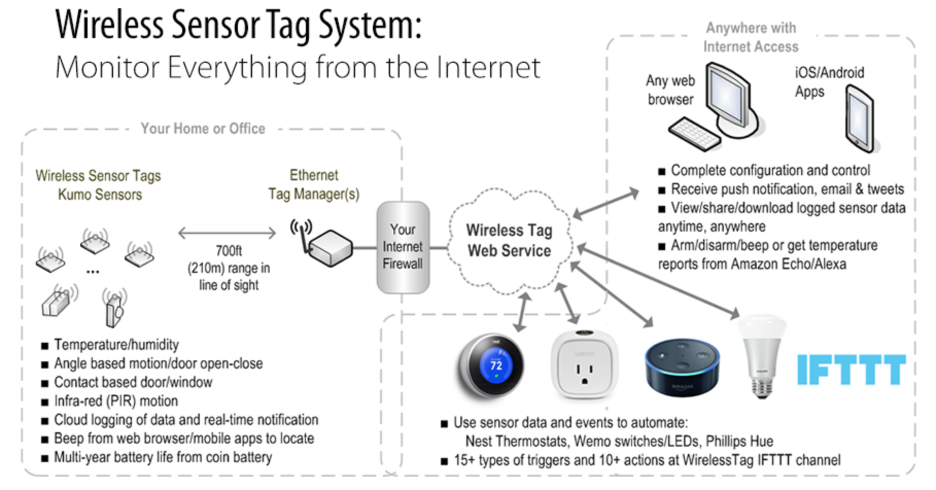
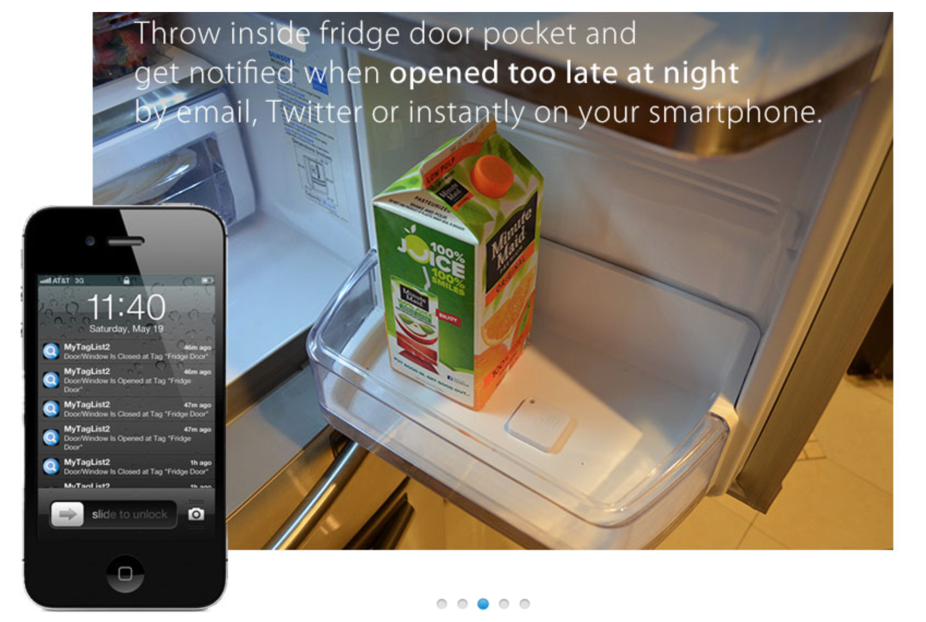
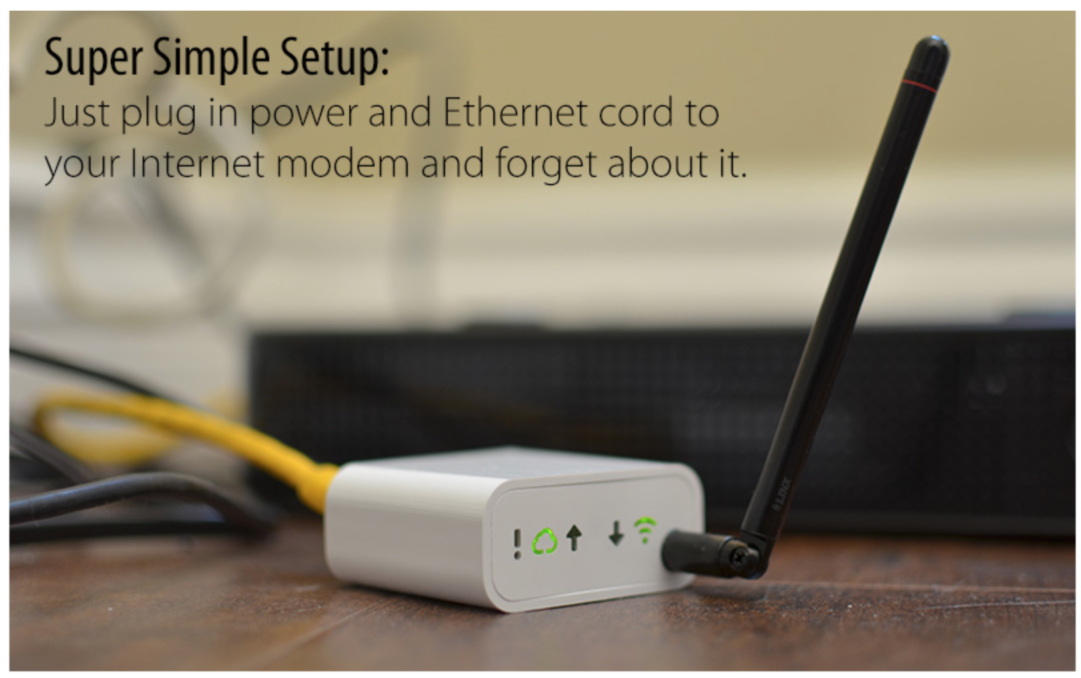
Appendix A – Sensors in Smart Home IoT Devices
About the prevalent sensing modalities using in real-world commercial products as well as research prototypes.
Notes:
A. Sensors in Smart Home IoT Devices
smart homes裡很多的IoT devices都是商業化的。我們要介紹一些普遍流行的感測模式(sensing modalities)，和他們實際應用的商品及研究模型(search prototypes)，呈現在TABLE I。
Microphone 提供給voice-activated controls
Smart speakers: Amazon Echo、Google Home
TVs
Passive Infrared(PIR) sensors monitor movements
Motion detectors
Accelerometers 用簡單的訊號來代表object status information， on-object sensing devices
door open/close/knocking
Power Meter 應用設備的用電量 隨著smart grid的出現，他也越來越受歡迎。
Geophone 地震(seismic)的sensors 工業和學術界都注意到它在building health、occupant monitoring(via gait detection)的可應用性(applicability)。
此篇就是用這幾個目前流行的IoT device不同的偵測模式來證明他們是共同位於(co-located)同一個物理邊界。

Slide 26
Background
Human-in-the-Loop-based Pairing (Tranditional)
Seeing-is-Believing authenticates other device’s public key by taking a picture of a 2D bar code.
Bluetooth and Wi-Fi requires humans to enter passwords on the devices intended for pairing.
Usability concerns: they are not applicable in smart.
Notes:
Human-in-the-Loop-based Pairing
先重點介紹使用人(human-in-the-loop)在解決的的安全配對協議(secure pairing protocols)。
Seeing-is-Believing：用barcode(the hash of public key)來認證
其他的工業標準 Bluetooth Secure Simple Pairing Wi-Fi Protected Setup：要輸入密碼去配對
這些解決方法，從可用性(usability)來看，不適用於smart home。

Slide 27
Related work
Context-based Pairing
Miettinen et al. : recurring authentication using ambient sound or light. Devices co-located at one household would experience similar context as opposed to devices in a neighbor’s house. 用周遭聲音光線
Schurmann et al. : similarly. But leverage short audio. 短音訊
Rostami et al. : a key agreement scheme between an implanted heart with its remote programmer. They establish a shared key by extracting entropy bits from measuring the patients heart beat. 個人心跳的entropy當成fingerprint
Han et al. : recurring authentication across trucks driving on a highway by sensing context from the road bumpiness using accelerometer.
Notes:
Context-based Pairing
研究人員也會使用context-based pairing protocols，在沒有人為介入的情況下，配對on-board sensors，來捕捉能夠觀察到的context。
Miettinen等人提出：藉由周遭的聲音或光來配對devices時來循環認證(recurring authentication)。在同一個家庭的co-located devices，比起鄰居家，會經歷相似的context，
Schurmann等人提出相似的想法：但利用比較短的聲音做為安全配對的context。
Rostami等人提出：key agreement scheme 放入在remote programmer下的implanted hear。他們藉由從監測病人的心跳中抽取出entropy bits，來創shared key。
Han等人提出：用加速度計來測量卡車在高速公路崎嶇不平的context，進行循環認證(recurring authentication)。
雖然這些方法是進行context-based pairing schemes有希望的第一步，但他們都直接專注在利用一致的sensor pairs在分析e.g.microphones, accelerometers, other sensors using direct signal.
不像是homogeneous context-based pairing schemes。
Perceptio 指出了困難但是有趣的問題：如何讓不同的(heterogeneous) sensor型態來獲取相同的contextual information。

Slide 28
Models and Assumptions
Notes:
+Abstract

Slide 29

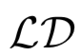
A. Threat Model
Threat Model goals & capabilities of attackers
Goal: to leak private information of home occupants by eavesdropping on the communication between IoT devices.
Notation:
: attacker devices placed outside of the house but within the wireless communication range, succeeds in fooling a legitimate device.
: legitimate device inside the house to accept the pairing as another
Approach: Shamming & MitM
Notes:
A. Threat Model of attackers的goals & capabilities
goals: 藉由竊聽IoT devices之間的通訊來 leak private information of home occupants。
launch the attack：
Shamming attack 𝑴：attacker’s device。在房子外但是在無線通訊範圍內。成功欺騙了合法的裝置。 𝑳𝐷：合法裝置。在屋內，接受跟其他𝑳𝐷配對。

Slide 30
A. Threat Model
launch three types of Shamming attacks.
(1-a) Eavesdropping attack: sense from outside. Following three levels of capabilities :
normal-level of resources: with standard off-the-shelf IoT sensors comparable to
medium-level of resources: with higher-end off-the-shelf consumer electronic devices
powerful-level of resources: with asymmetric capabilities E.g., military-grade thermal imaging and x-ray vision
Notes:
𝑴會發起三種形式的Shamming attacks：
(1-a)的Eavesdropping attack：藉由從外部竊聽發生在裡面的事件 3 level capabilities
normal-level of resources：與房子內𝑳𝐷有一樣(現成, (off-the-shelf))標準的IoT sensors
medium-level of resources：比起normal-level of resource更強大，裝在更高端(higher-end)的現成(off-the-shelf)消費電子設備。
powerful-level of resources：有不對稱的能力。e.g.軍事等級的熱圖(military-grade thermal imaging)或是x光圖(x-ray vision)。意思應該是裡面就算不用有設備我也能直接觀察？

Slide 31
A. Threat Model
(1-b) Signal Injection attack: creating events with large noise or vibration from outside E.g. using jack-jammer
(1-b) Signal Injection attack: by injecting spoofing signals to , allow both and to perceive simultaneous event signals and accept the pairing.
Notes:
(1-b)的Signal Injection attack：藉由創造來自外部很多噪音或是震動的事件。e.g. jack-jammer＝挖馬路的電動錘
(1-c)的Sensor Spoofing attack：向𝑳𝐷注入欺騙信號。 攻擊者再次發起任何一種這些攻擊中的一種，試圖讓𝑴和𝑳𝐷都能同時感知事件信號，最終成功欺騙𝑳𝐷接受與𝑴的配對。

Slide 32
A. Threat Model
Man-in-the-middle (MitM): key agreement messages between a pair of LDs by simply intercepting messages transmitted over the wireless medium. E.g. injection, replay, modification, and blocking/deleting
Notes:
Man-in-the-Middle attack：在LD配對時，簡單的攔截他們傳到無線的媒體。 攻擊者可以在communication channel使用用很多原始intercepting，injection, replay, modification, blocking/deleting。

Slide 33
B. Assumptions and Constraints
About the assumptions and constraints of Perceptio
The physical boundaries of a house draw a natural trust boundary for deployed devices.
Who owns the devices and operates
Non-authorized personnel do not have access to the physical space
The family members and authorized guests are not malicious.
Devices brought into the home for prolonged periods of time is sufficient to bootstrap a trusted connection to the IoT network.
A single-family homes are made up of a number of joined rooms, and the separating walls actually present numerous physical boundaries.
The walls are bound to induce a non-negligible attenuation factor
IoT devices to act as “bridging devices”, if needed.(No full pairwise connectivity)
Notes:
B. Assumptions and Constraints of Perceptio
假設房子的物理邊界=給部屬的LD的自然信任邊界
這個假設會影響：哪些LD在邊界內(擁有哪些LD)＆被常見的實體操作
未經授權的人不能進入這個實體的空間，因此沒有IoT devices的管控權。
假設家庭成員還有經過授權的客人都沒有惡意 如果是惡意的客人或是本身就不安全的房子，那就跟安全pairing無關，不在討論範圍。 e.g. 如果有一個家庭成員或經過授權的客人都能夠使用這個屋子，那長時間被帶進來的devices也會被認為是值得信任的。那這個屋子的部屬證明是足夠去bootstrap的，對IoT network進行信任的連線。
single-family home都是有好幾個房間，在家裡分隔的牆也都是代表好幾個物理邊界。（雖然現在是針對single-family detached housing，但為來延伸一定可以用的～） 在同一個家裡的sensors因為有相同的物理上的結構，會感測到相同的事件。但是牆壁一定會帶來訊號衰弱的現象(non-negligible attenuation factor），不同的傳播介質會造成機械訊號衰退和減弱。更具體的來說，已知牆壁和插頭會造成聲音和震動減振、反射、衍射。然而，內部的牆壁比起外牆會造成比較小的減弱效果，我們期待nearby IoT devices能公平的傳播訊號，至少要有足夠的數量來允許IoT network的連接性(connectivity)。完全全部pairwise連接是沒有必要的。後面會討論到，如果有需要，可能會有很少數量的IoT devices扮演bridging devices的角色，去協調安全配對時能不理會房子內部的牆。 在其他的case中，我們設計Perceptio去依賴1.主要的觀察：房子外的sensors不能持續的觀察(consistently perceive)屋內相關的活動，且2.要像LD一樣相似忠實(similar fidelity)。

Slide 34
B. Assumptions and Constraints
Sensors outside cannot consistently perceive the relevant activities inside with similar fidelity as .
Future extensions of Perceptio could extend to other multi-tenant attached housing.
Notes:
在其他的case中，我們設計Perceptio去依賴1.主要的觀察：房子外的sensors不能持續的觀察(consistently perceive)屋內相關的活動，且2.房外的sensors也不能像LD一樣相似忠實(similar fidelity)。

Slide 35
Entropy extraction and Fingerprinting
Notes:
會先講不同資源共享的entropy，用來達成IoT devices之間的信任。
再講如何透過fingerprinting mechanism來extract entropy。

Slide 36
A. Entropy Extraction
Entropy Extraction: Let devices capture and extract shared entropy from the device’s surroundings, and establish (pseudo-)random key bits for cryptographic key agreement protocol.
Goal: Help devices extract shared entropy
Approach: Deliberately inject randomness to the devices within the physical boundary
Implement: a signal injecting device that outputs signals are encoded random bits.
Traditional key establishment schemes : “deliberate entropy”
Notes:
A. Entropy Extraction
解釋： 類似依賴entropy來源的加密協議(cryptographic key agreement protocol)來建立偽(pseudo-)random key bits，我們使devices能夠從周遭 捕捉和萃取出shared entropy的方法。之後會在Section 5講到bootstrap trust。
目的：幫助devices extract shared entropy
方法：故意地注入隨機性給在實體邊界(physical boundary)裡的devices。
實現：透過引入signal injecting device(e.g. injecting vibration motor or speaker, and encoding random bits)來實現。
類似於：傳統的key establishment schemes時提供的“deliberate entropy”。
問題：關於多個感測模式(sensing modalities)的
cost
usability
scalability

Slide 37
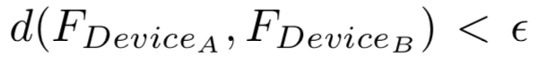
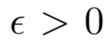
A. Entropy Extraction
Different from traditional: “natural entropy” inherent randomness of events in a device’s surroundings to establish a context fingerprint.
Source of entropy: inherent randomness E.g. walking, talking
Advantages: predicting the precise timing of events within the physical boundary at a millisecond-scale granularity is hard.
A degree of tolerance for “similar” fingerprints
After matching: and
Notes:
解決問題：依據事件(device周遭)原本就有的隨機性(inherent randomness)去建立context fingerprint，也就是”natural entropy”。
entropy來源(source of entropy) inherent randomness e.g. knocking, walking, talking etc
entropy來源(source of entropy)的好處 利用此隨機來源來給加密協議，使攻擊者很難預測事件在實體邊界裡發生的精確時間(millisecond-scale granularity）。
entropy來源(source of entropy)的使用目的 使用事件時間發生的隨機性，fingerprint產生機制(generation mechanism)基本的目標就是：兩個devices如果符合場景內的contextual requirements，希望能能產生相似的fingerprint。
v.s.傳統安全配對協議 不同之處：我們的問題要求對不相似的devices和他們各自的感測能力要有一定的容忍度，也就是放寬Fingerprints F(deviceA)和F(deviceB)在數值相等的要求，而不是滿足兩者要小於適當的距離d(F(deviceA), F(deviceB) ) < e，並且兩者匹配(match)時才要考慮小小的容錯e>0。
在此討論fingerprint mechanism，fingerprint matching的細節在後面討論。

Slide 38
B. Context Fingerprinting
Fingerprint Extraction Algorithm
3 insights for fingerprint mechanism of Perceptio
raw signals obtained by different sensor types will have different characteristics
sensors on different devices will perceive the same event in roughly the same way
inter-event timing measured by different sensors will be roughly the same.
An approach combines event detection, event clustering, and per-cluster inter-event timing.
device generate a set of fingerprints(many clusters)
one for each cluster represents the observable context
Devices do not need to know what specific types of events are occurring.
Notes:
B. Context Fingerprinting
下面三大點會解釋fingerprint extraction algo.：
多種event types要如何影響Perceptio context fingerprinting
Perceptio要如何保證key agreement protocol所需足夠的entropy
fingerprint extraction algo.的優點
接下來用三大點解釋fingerprint extraction algo.：
Fingerprint Extraction Algo.:
Perceptio的fingerprint mechanism
main idea based on 3 insights
insights( main idea based on these primary insights)
從不同的devices和sensor types獲取的raw signals，會有不同的特徵(characteristics)
不同的devices上的sensor會以大致上相同的方式觀察到同樣的事件
不同sensors測量到事件之間的時間會大致相同
當把這些insights結合，會提出一個方法結合了：事件偵測(event detection)、事件分群(event clustering)、每群事件之間的時間間隔(per-cluster inter-event timing)
這個方法，具體來說就是：每個device會產生一組fingerprints，而每一個cluster有一個fingerprints（不懂的話看下述），共同代表觀察到的context。（Note: devices不需要知道正在發生的事件是什麼類型。
由上述core ideas可知，context fingerprinting approach是通用的，之後會具體的描述案例和實驗評估。

Slide 39
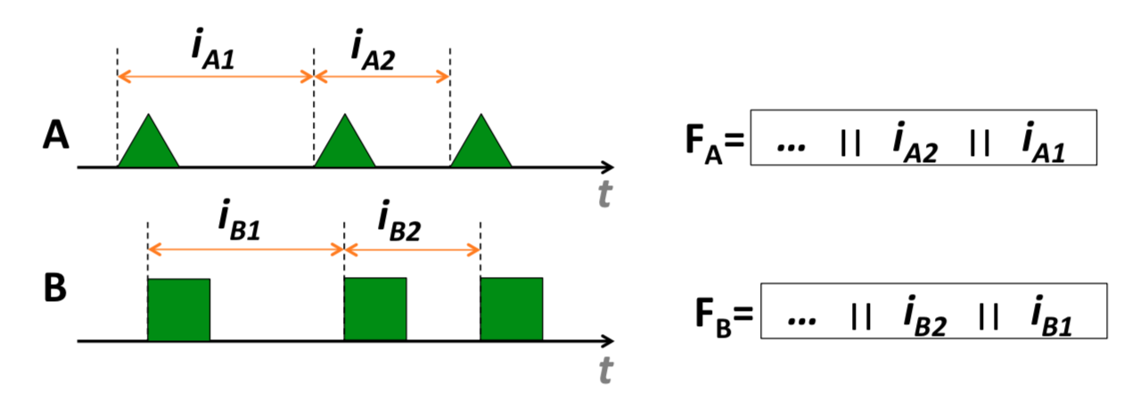
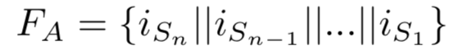
B. Context Fingerprinting
1. Fingerprint Extraction Algorithm
How to create the fingerprints: the start times and corresponding inter-event intervals
event sequence: S
inter-event times: i_{S} (Intervals: starting points of subsequent events observations)
fingerprint: F (bit-representations)
Notes:
如何產生fingerprints：start times & inter-event intervals（跟下一個same type的event之間的time） 偵測事件時，
event sequence: S
inter-event times: iS
fingerprint: F

Slide 40
B. Context Fingerprinting
1. Fingerprint Extraction Algorithm
Do not need to have a common representation of the event detected
Event detection does not need to be perfectly synchronized.
Just make the inter-event timings match
Notes:
所以過程為，每個device會
收集time-series data
呈現 偵測到的事件的signal processing
根據signal properties分群
對每個event cluster創造fingerprint
用Fig.3解釋
從圖中(a)有強調兩個sensors偵測事件時不需要有共同的representation，但兩者的inter-event timings match。(Note:兩者之間不需要同步）

Slide 41
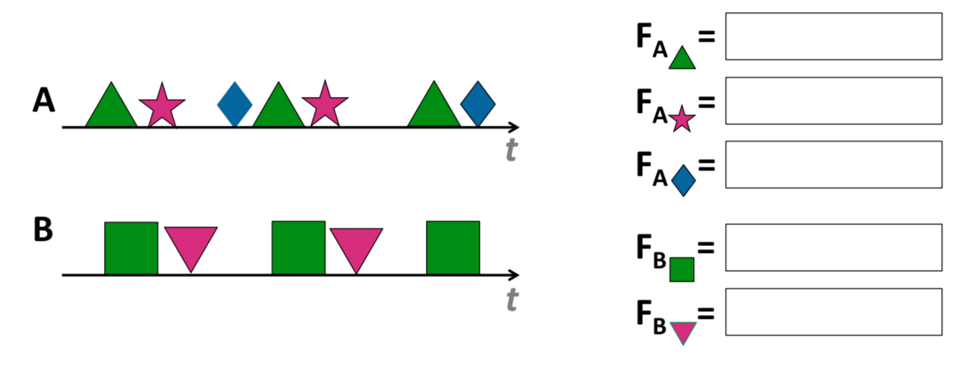


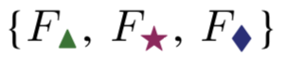
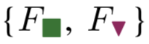
B. Context Fingerprinting
1. Fingerprint Extraction Algorithm
A’s event clusters:
B’s event clusters:
A’s sets of per-cluster fingerprints:
B’s sets of per-cluster fingerprints:
Notes:
圖(b)中：A是microphone, B 是geophone。 microphone會對聲音更敏感，geophone會對震動更敏感； 兩者都偵測得到咖啡機。（也都可以偵測不同的event type e.g. talking, walking, making coffee） A的event clusters：
B的event clusters:
A的sets of per-cluster fingerprints:
B的sets of per-cluster fingerprints:
（接續“如何產生fingerprints...”)
接者彼此交換搜尋pairwise，看fingerprints有沒有match。（在Section 5會說）

Slide 42
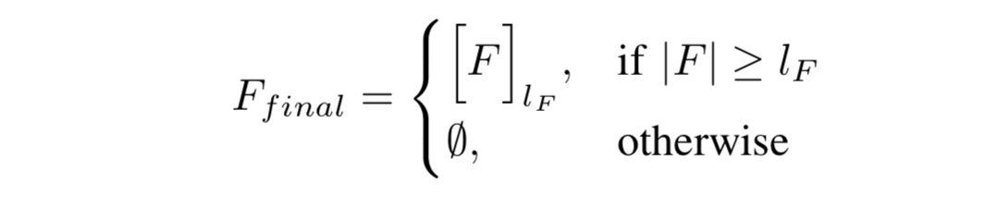
B. Context Fingerprinting
Fingerprint Entropy Perceptio bootstraps its trust from the entropy of event timings in the environment. fingerprint depends on
the number of similar events observed
the bit resolution of each interval
F: intervals i_{Ak}, for k = 1,...,n l_{F} : fingerprint length. (provide sufficient entropy otherwise F is truncated to l_{F} bits.)
Notes:
Fingerprint Entropy
Perceptio bootstraps 信任從環境中帶來的event timings entropy。
Intervals被轉換成bits of the fingerprint。 (Intervals: starting points of subsequent events observations)
fingerprint的entropy是依賴
相似events的數量
每個interval解析的bits
用公式表達F
F描述intervals i(Ak)的bit values的連接關係。(k=1~n)
F長度：也就是你收集的數據要夠大。F長度 不能比 可以接受的fingerprints l(F)還小，不然F會被截斷成l(F)bits。關於l(F)的需求，是為了提供充足足夠的entropy，會在Appendix C解釋。
(會容易被攻擊）

Slide 43
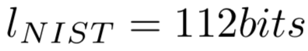
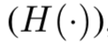
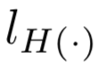
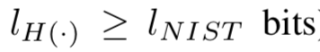
Appendix C – Security Analysis
How an attacker would try to launch attacks to compromise the shared secret in Perceptio’s cryptographic protocol.
Attacker’s goal: acquire ki generated by A
Attacker’s approach:
Bruteforcing attack
Dictionary attack on the hash, H(k_{i}) and then directly bruteforce the key, k_{i} which is transmitted together with C_{ai}
Define , as recommended by NIST
Cryptographic hash function . It’s length represented as
If , bruteforce attack is computationally infeasible. E.g. the state-of-the-art secure cryptographic hash function such as SHA-3 which is well above l_{NIST} bits
Notes:
我們現在分析Perceptio’s cryptographic protocol，也就是呈現攻擊者如何試著發動攻擊來危害shared secret。
具體來說，每個攻擊者的目標是獲取A產生的k(i)。(Figure 18 step2)。
我們分析出，攻擊者為實現上述目標而可能發起的兩種攻擊類型：(v.s Shamming & MiTM是為了竊聽到隱私的資訊，現在是為了獲取k(i)）
Bruteforcing attack攻擊者首先藉由dictionary attack on the hash H(ki)，嘗試直接暴力破解key k(i)，因為H(ki)會直接一起轉變(transmit)成C(Ai)。(Figure 18 step3)。根據NIST的建議，我們定義
只要cryptographic hash function
的長度
比
的bits還長，
暴力攻擊在計算上
是不可行的。
我們利用最先進的secure cryptographic hash function（e.g. SHA-3）來看，他們都遠遠超過
的bits。

Slide 44
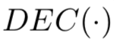
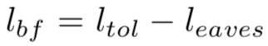
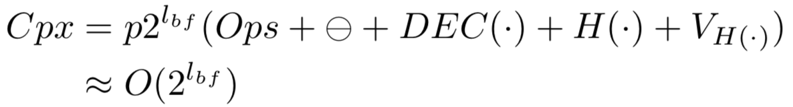
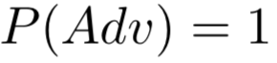
Appendix C – Security Analysis
: Attacker’s approach
Eavesdropping attack
A more sophisticated attacker pretends to be a legitimate device placed within the physical boundary by trying to open the commitment.
Attacker might capture some of the signals relying on transmission media which affects the amplitude of the original signal. leads to less amount of computations to acquire k_{i}
So, if l as the number of bits of the fingerprint, we get:
If the computational complexity, C_{px} is as following the attacker’s success probability is
Notes:
Eavesdropping attack一個更複雜(sophisticated)的攻擊者假裝成為一個放置在物理邊境中的合法的裝置，嘗試要打開(open)commitment。這個攻擊者發動一個eavesdropping attack是因為他的裝置在邊界的outside，所以嘗試捕捉到某些events。因此，這些裝置可能捕捉到某些signals，取決於傳輸介質(transmission media)以及原始信號的幅度(the amplitude of original signal)。因此，比起不知道任何資訊來做暴力攻擊，這個攻擊者有更多的資訊來猜測fingerprint（可以用
來decode。但這反過來導致獲得ki的計算量減少。（範圍縮減）
我們提供
作為fingerprint的bits長度(數量)，攻擊者也知道這是竊聽攻擊的結果。
因此，我們提供
作為攻擊者需要暴力攻擊的bits數量，為了成功知道
攻擊成功的長度bits。
所以也就是
因此，攻擊者成功的機率是
Adv是Attack Devices，其中計算的複雜度為
所以全部為下:CPX
p是Fs的數量
V(H.)是hash verification（為了驗證input不同時output相同）
當l(bf) >= l(NIST)時，Ｃpx在計算上是沒有可行性的。
因此，從竊聽那邊獲得的l(eaves)應該受到
Bf = tol-eavse
的限制。

Slide 45
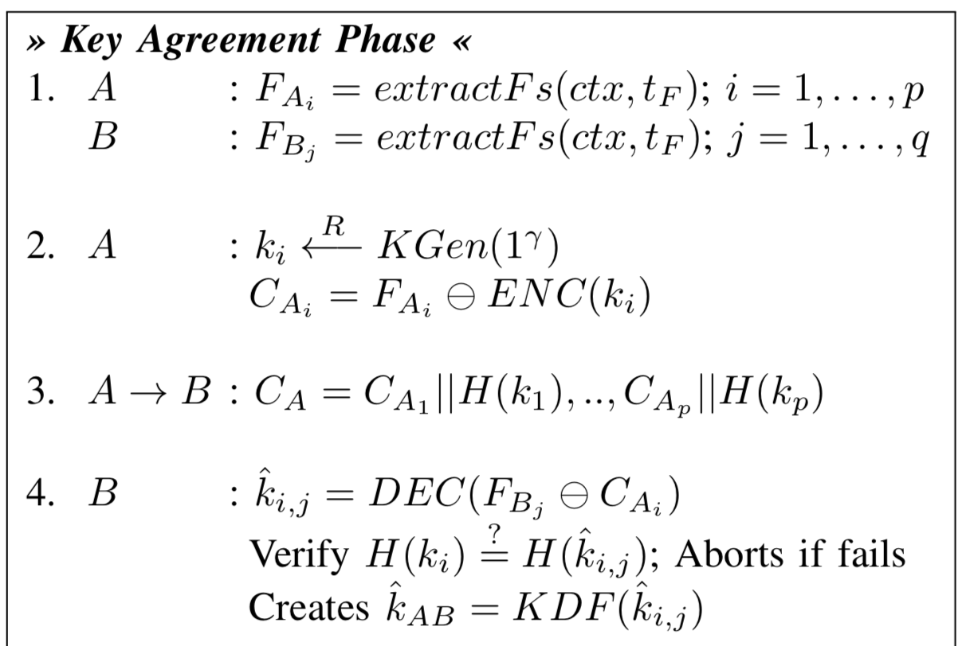
Appendix B – Perceptio Protocol Details

Slide 46
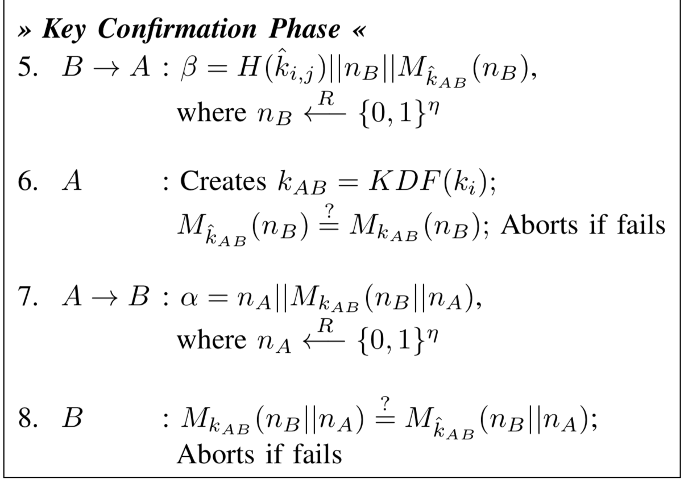
Appendix B – Perceptio Protocol Details

Slide 47
B. Context Fingerprinting
Advantages of Fingerprint Extraction Algorithm The devices are not required to be time synchronized as
the clock rates are consistent across the devices.
fingerprint extraction can be triggered by event occurrences.
fingerprints are generated based on event intervals.
fingerprints will be similar regardless of time synchronization.
fingerprints are independent of the varying amplitudes of signal
location of the sensors relative to the source of the event.
This is also because the algorithm makes use of the starting point intervals rather than the signals themselves.
Notes:
Advantages of Fingerprint Extraction Algorithm
對於Perceptio fingerprint extraction algo有一系列的優點， （使用starting point of intervals而非signal本身的原因如下）
devices不需要時間上的同步，因為
fingerprint會是相似的，無論時間上有沒有同步
clock rates在devices之間是一致的
fingerprint extraction可以被event的發生來trigger
是根據event intervals（而非event的發生次數)來產生fingerprints
fingerprint獨立於signal的變化幅度(varying amplitudes)
變化幅度(varying amplitudes)會因為sensor和source of event

Slide 48
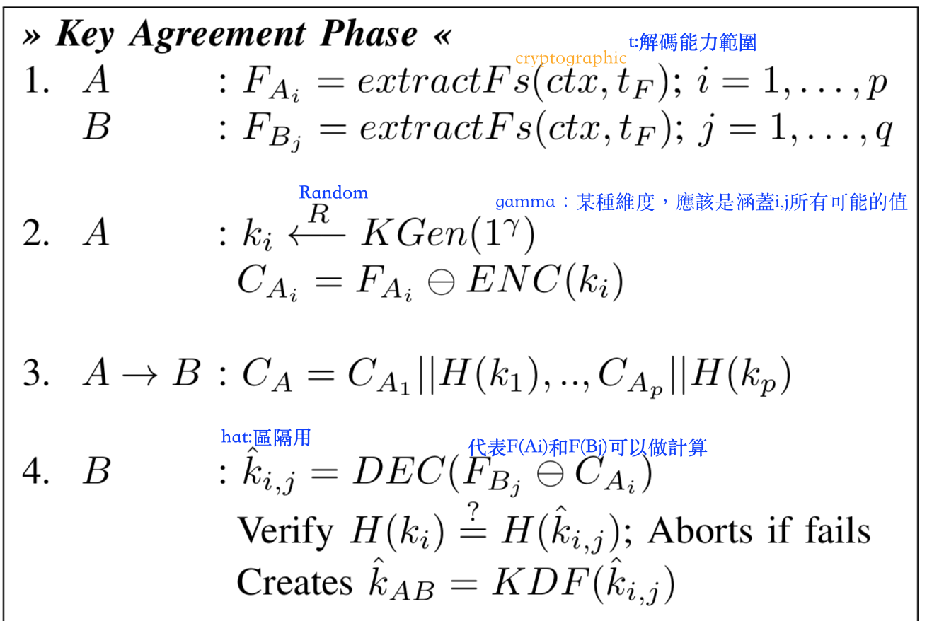
Appendix B – Perceptio Protocol Details

Slide 49
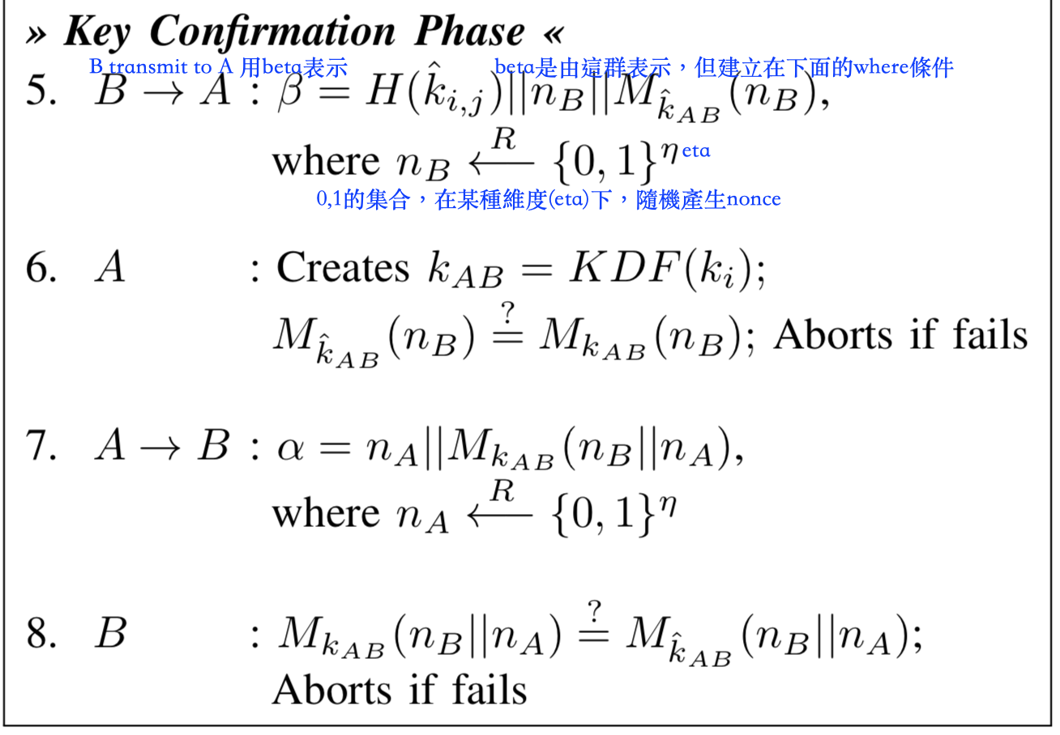
Appendix B – Perceptio Protocol Details

